Slide 1
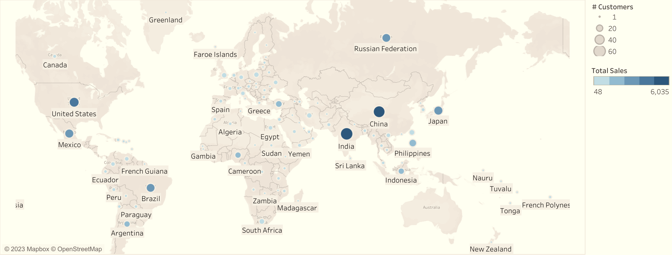
Rockbuster online video service launch
Celine Terfloth
Data Immersion
September 2023

Slide 2
Objective
Help BI department with launch strategy for new online video service
Key questions:
Which movies contributed the most/least to revenue gain?
What was the average rental duration for all videos?
Which countries are Rockbuster customers based in?
Do sales figures vary between geographic regions?
Where are customers with a high lifetime value based?

Slide 3
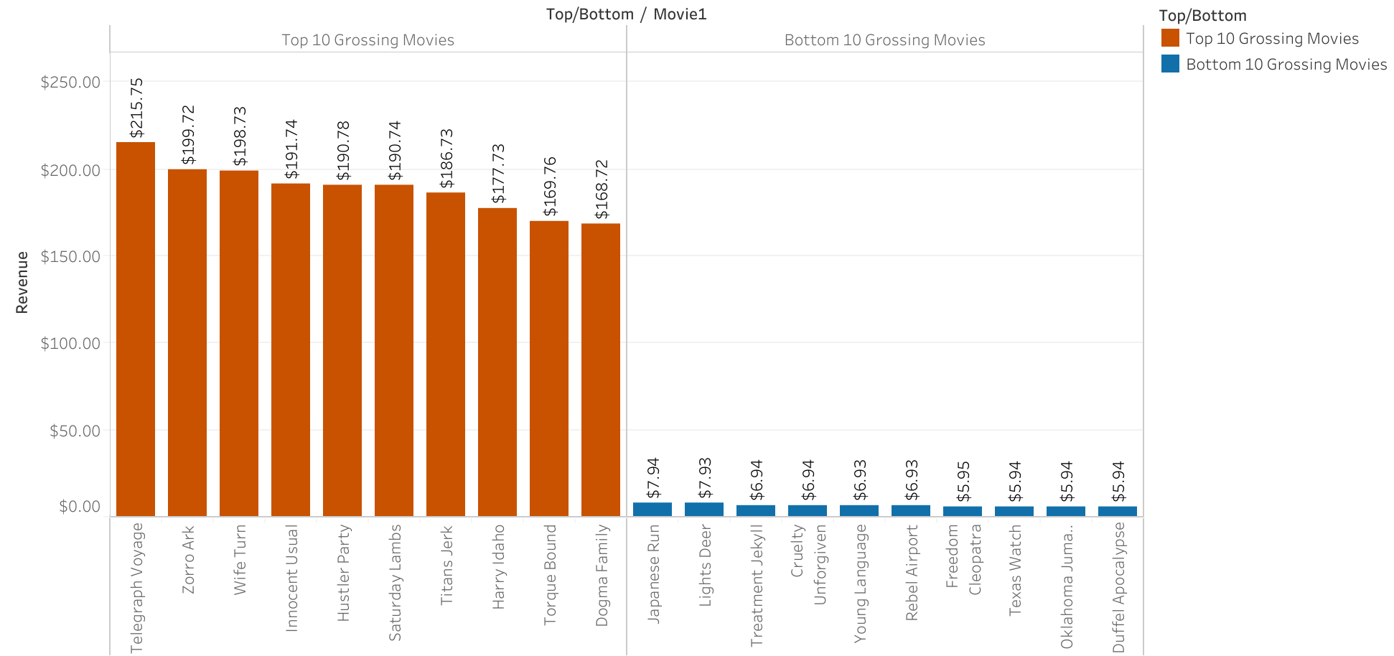
Movies contributing most and least to revenue
Bar chart showing the most and least profitable movies in Rockbuster database
959 movies total
Movie genre and rating don’t seem to be the driving factors affecting revenue
What could be causing the difference in revenue?

Slide 4
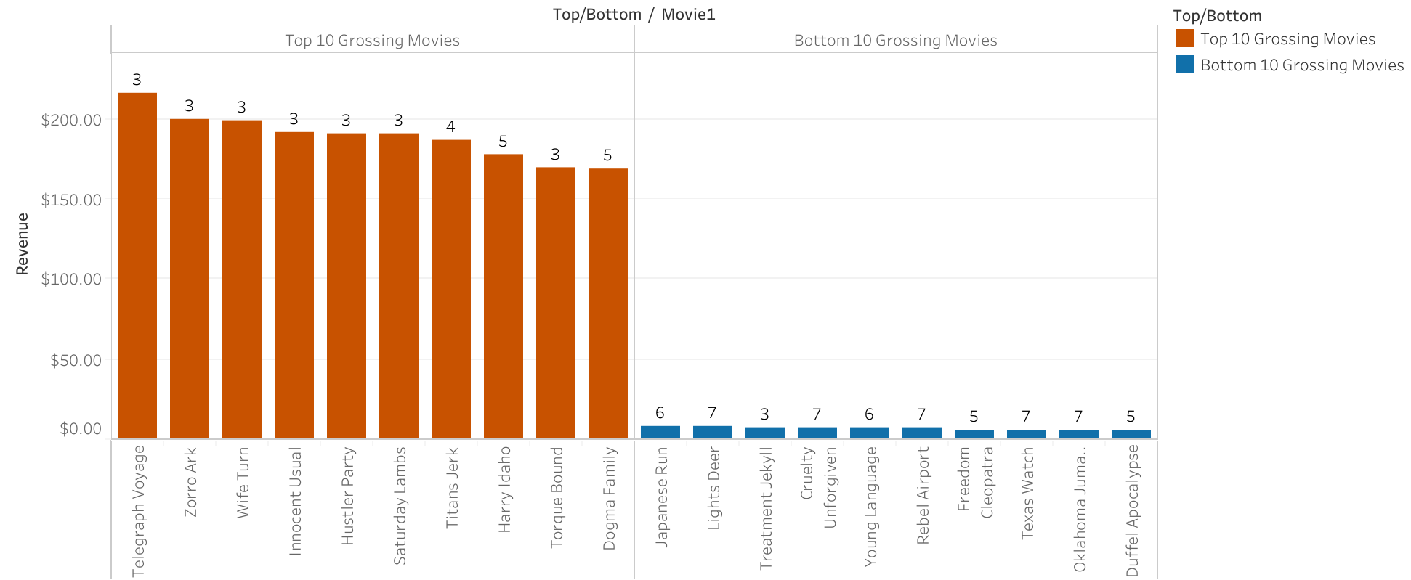
Average Rental duration of high vs. low grossing movies
Average rental duration across all rentals is 4.98 days
Average across top grossing movies is 3.5 days
Low grossing movies average 6 days
Could be due to disinterest from customers not watching film in one sitting

Slide 5
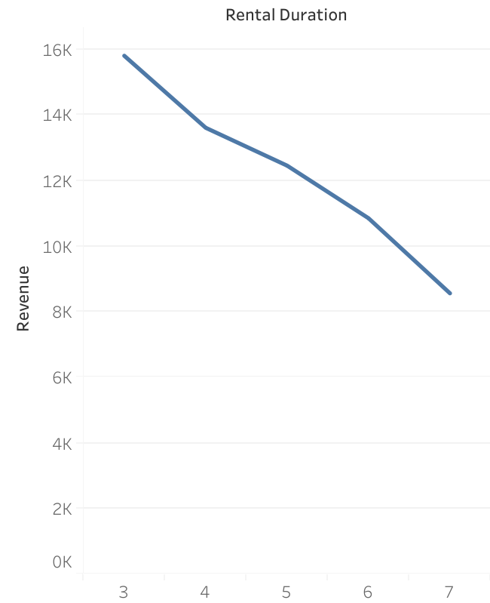
Long rentals could be costing
Low grossing movies have longer rental periods
Longer rentals are impacting profits
Depending on subscription strategy, Rockbuster should start invoking rental extension fees after 4 days.

Slide 6
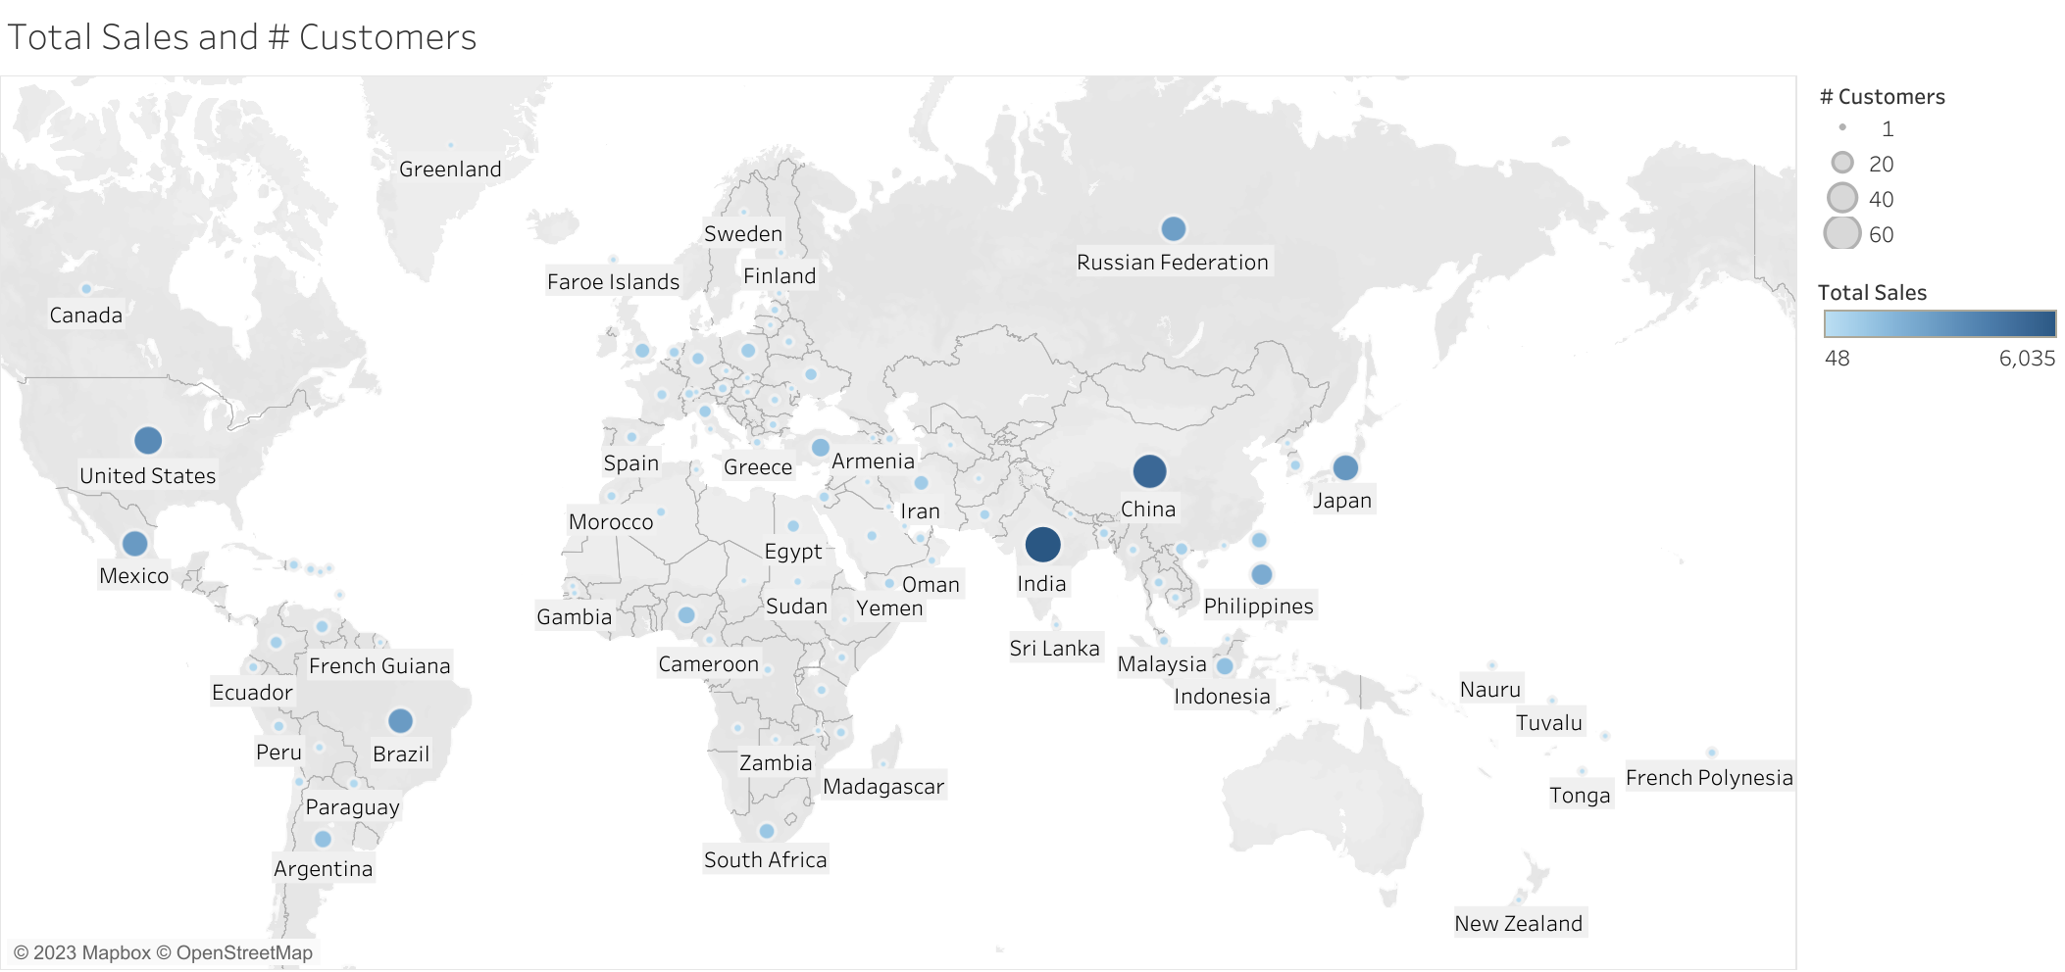
Where are rockbuster’s customers?
Customers in 109 countries
Sales figures vary by region
India, China, and United States are Rockbuster’s most profitable countries

Slide 7
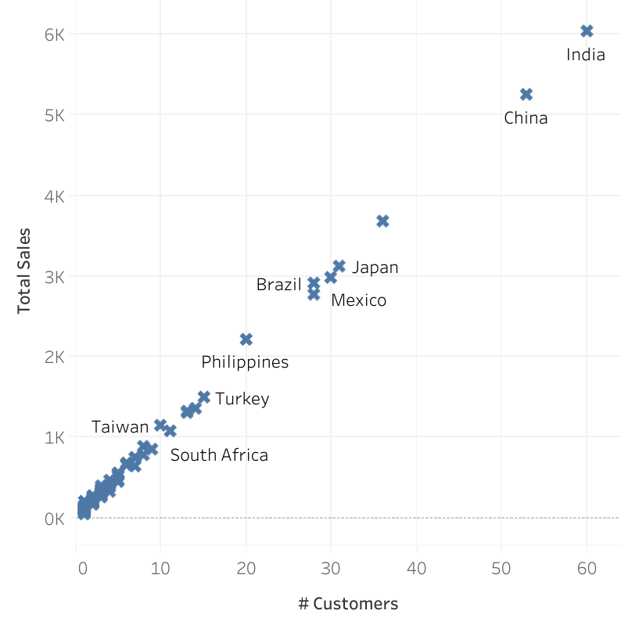
Rockbuster’s customer base
As number of customers increases, so do total sales
Total sales and # customers are positively correlated
Room for growth even in most profitable regions
Prioritize marketing activities and budget on countries with more established customer bases

Slide 8
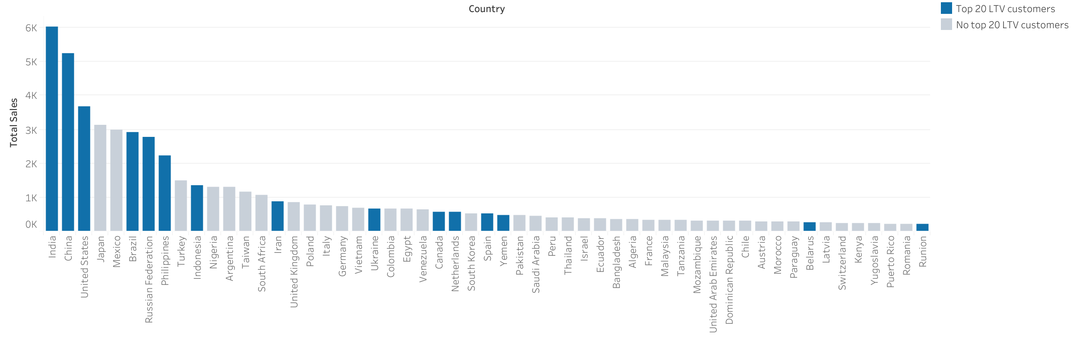
Where are high ltv customers?
Neither sales or number of customers in certain countries seem to influence number of high LTV customers
Many top 20 LTV customers exist in less profitable countries

Slide 9
Rockbuster’s top 5 ltv customers
Name | Country | City | Lifetime Value | Country Sales Ranking
Eleanor Hunt | Runion | Saint-Denis | $211.55 | 55
Karl Seal | United States | Cape Coral | $208.58 | 3
Marion Snyder | Brazil | Santa Barbara d’Oeste | $194.61 | 6
Rhonda Kennedy | Netherlands | Apeldoorn | $191.62 | 26
Clara Shaw | Belarus | Molodetno | $189.60 | 48
Only 2/5 top LTV customers live in top 25 grossing countries
These high value customers are an asset to Rockbuster
Kickstart growth in smaller markets by offering referral incentives to high LTV customers in lower grossing countries.

Slide 10
Recommendations
As Rockbuster transitions online, there is lots of room for growth
3 main recommendations to focus on:
Depending on subscription strategy, Rockbuster should start invoking rental extension fees after 4 days.
Prioritize marketing activities and budget on countries with more established customer bases.
Kickstart growth in smaller markets by offering referral incentives to high LTV customers in lower grossing countries.

Slide 11
Thank you!
See following slides for Appendix…

Slide 12
Appendix: summary statistics
Quantitative summary statistics for films in database:
Column | Minimum | Maximum | Average
Rental duration | 3 | 7 | 4.98
Rental rate | 0.99 | 4.99 | 2.98
Length | 46 | 185 | 115.27
Replacement cost | 9.99 | 29.99 | 19.98

